Slide 1
Модуль sklearn.preprocessing: возможности, классы (численные признаки)

Slide 2

What the sklearn.preprocessing module stands for?
Provides utilities to change raw data vectors into a more suitable form for further estimations and analysis.
Has different scalers, transformers, normalizers, helps to cope with outliers, etc.

Slide 3
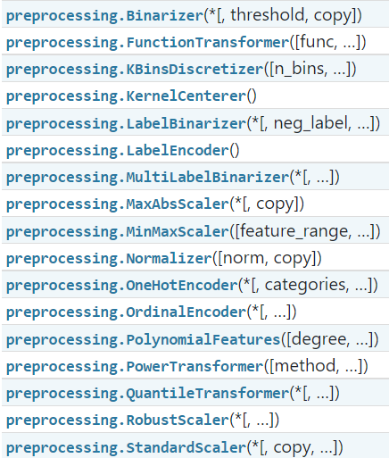
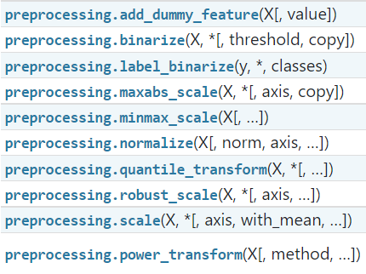
Classes
Functions

Slide 4

Classes
Functions

Slide 5

Keep calm and carry on!
preprocessing.binarizer(…):
[*a lot of data*] -> [0, 1, 1, 1, 0, 0,1 ,0, … , 1, 0, 0, 1]
preprocessing.FunctionTransformer(…):
f(x), [1,2,3] -> [f(1), f(2), f(3)]
preprocessing.KBinsDiscretisezer(…):
[1;9] -> [2,2,2,5,5,5,5,9,9]
etc.

Slide 6
MaxAbsScaler

Slide 7

preprocessing.MaxAbsScaler
Scale each feature by its maximum absolute value
It does not shift/center the data, and thus does not destroy any sparsity.
It’s not useful for data visualization, but for other purposes, e.g. if we have all numeric values and the biggest value means 100%, then every value gets normalized and shows its percent out of 100.

Slide 8
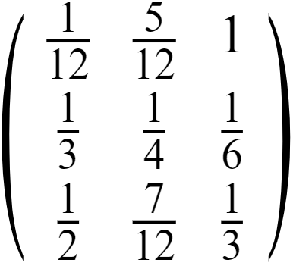
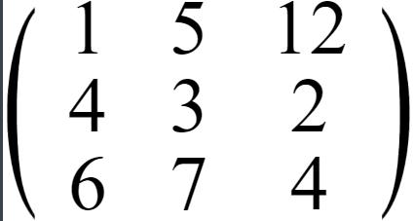
Suppose we have a matrix
------------>
MaxAbsScaler

Slide 9
preprocessing.MaxAbsScaler
copybool, default=True
Set to False to perform inplace scaling and avoid a copy (if the input is already a numpy array).
Parameters:
copy : bool, default=True
Set to False to perform inplace scaling and avoid a copy (if the input is already a numpy array).
NaNs are treated as missing values

Slide 10
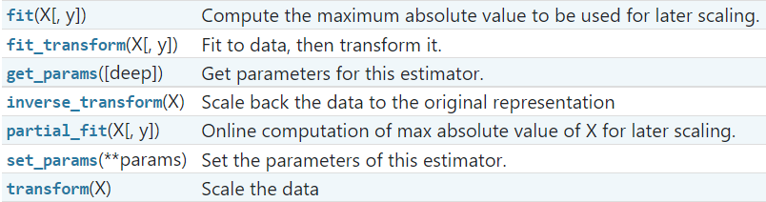
preprocessing.MaxAbsScaler
Methods:

Slide 11
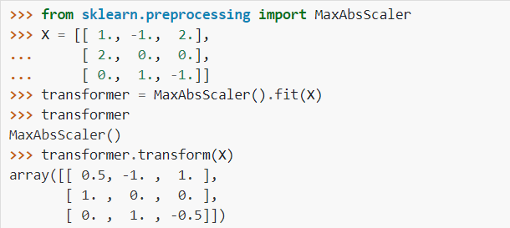
Example

Slide 12
Discretisation in sklearn.preprocessing

Slide 13

What is discretization?
Discretisation (binning, quantization) – way to group some continuous features into a discrete values

Slide 14
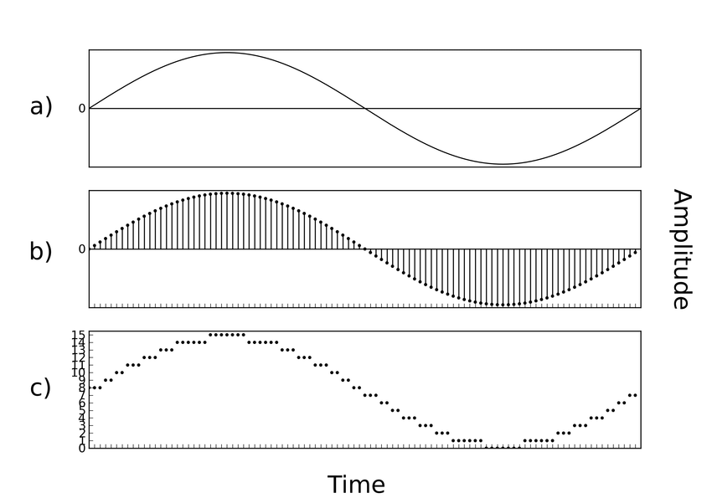

Slide 15

Discretisation in sklearn.preprocessing
preprocessing.Binarizer()
preprocessing.KBinsDiscretizer()

Slide 16
class sklearn.preprocessing.Binarizer
[*a lot of data*] -> [0, 1, 1, 1, 0, 0,1 ,0, … , 1, 0, 0, 1]
Parameters:
theresold : float, default=0.0 Feature values below of equal to this replaced by 0, otherwise 1
copy : bool, default=True Set to False to perform inplace binarization and avoid a copy

Slide 17
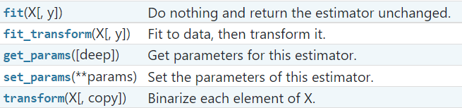
Methods:
class sklearn.preprocessing.Binarizer

Slide 18
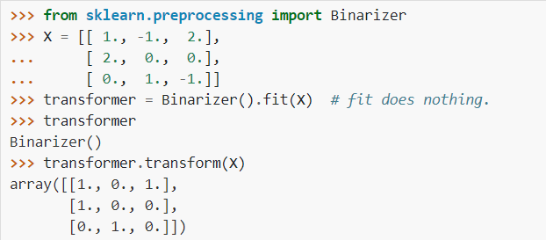
Example

Slide 19
sklearn.preprocessing.KBinsDiscretizer
[1;9] -> [2,2,2,5,5,5,9,9,9]
Parameters:
X : array-like of shape (n_samples, n_features)
Data to be discretisized
y : None
Ignored.

Slide 20

sklearn.preprocessing.KBinsDiscretizer
[1;9] -> [2,2,2,5,5,5,5,9,9]
Parameters:
X : array-like of shape (n_samples, n_features)
Data to be discretisized
y : None
Ignored.
y

Slide 21
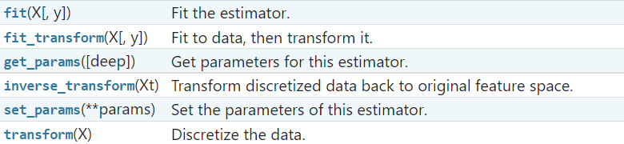
sklearn.preprocessing.KBinsDiscretizer
Methods:

Slide 22
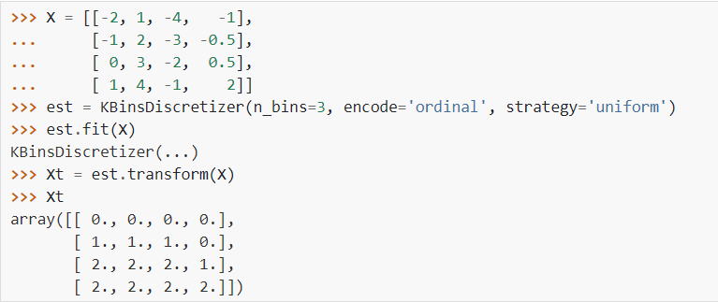
Example

Slide 23
RobustScaler

Slide 24
sklearn.preprocessing.RobustScaler
Scale features using statistics that are robust to outliers
This Scaler removes the median and scales the data according to the quantile range (defaults to IQR: Interquartile Range). The IQR is the range between the 1st quartile (25th quantile) and the 3rd quartile (75th quantile).
Centering and scaling happen independently on each feature by computing the relevant statistics on the samples in the training set. Median and interquartile range are then stored to be used on later data using the transform method.

Slide 25
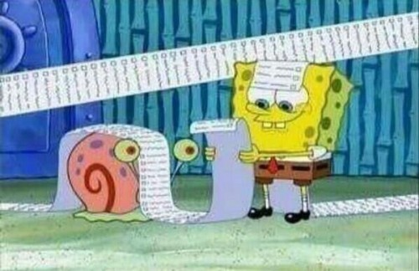
sklearn.preprocessing.RobustScaler
Parameters:
with_centering : bool, default=True
If true, center data before scaling
with_scaling : bool, default=True
If True, scale the data to interquartile range.
quantile_range : tuple (q_min, q_max), default=(25.0,75.0)
Quantile range used for calculations
copy : bool, default=True
If False, try to avoid a copy and do inplace scaling instead.
unit_variance : bool, default=False
If True, scale data so that normally distributed features have a variance of 1

Slide 26
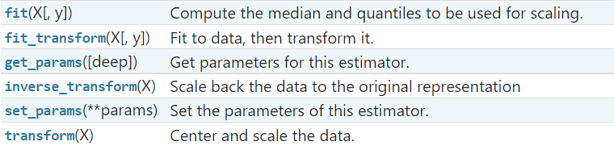
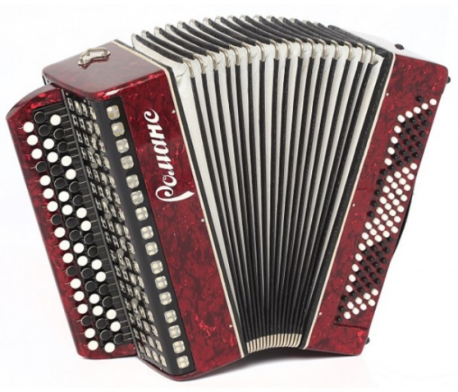
sklearn.preprocessing.RobustScaler
Methods:

Slide 27
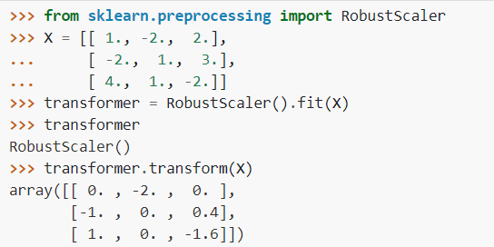
Example

Slide 28
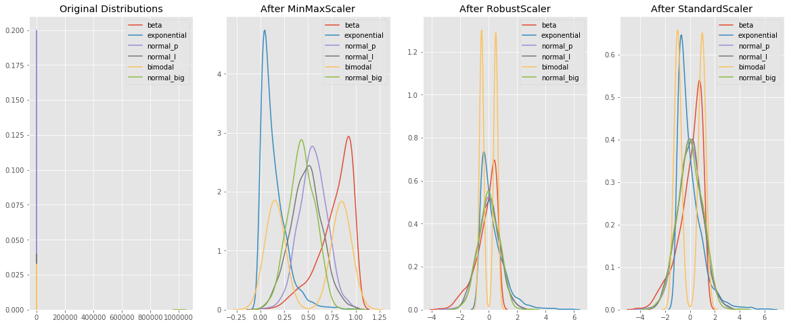

Slide 29
Links
https://scikit-learn.org/stable/modules/classes.html#module-sklearn.preprocessing
https://towardsdatascience.com/scale-standardize-or-normalize-with-scikit-learn-6ccc7d176a02

Slide 30


